Slide 1
CHAPTER FOUR
Plastics, Rubber and Fiber

Slide 2
4.1. Introduction to polymers
What are polymers?
➲ What are the building blocks of polymers?
What is base for the classification of polymers?
Why we need to study polymers?
What is d/c Plastics, Rubber and Fiber?
➲ What are the applications of polymers?

Slide 3
4.1. Introduction to Polymers
Polymer research rapidly spread throughout the world after 1930 & this led to the development of many synthetic polymers including nylon, polyethylene & polyvinylchloride.
The term polymer comes from two Greek words: polys which means many & meros which means parts/unit.
Therefore, a polymer is a high molecular weight compound made up of hundreds or thousands of many identical small basic units (monomers) of C, H, O or Si atoms.
The monomers are linked together covalently in a chemical process known as polymerization.

Slide 4
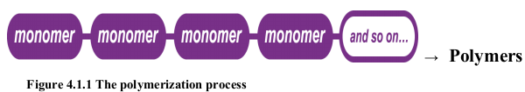
Introduction to polymers
A polymer is a large molecule (macromolecule) composed of repeating structural units.
These subunits are typically connected by covalent chemical bonds.
Although polymer is sometimes taken to refer to plastics, it actually encompasses large class comprising of both natural & synthetic materials with a wide variety of properties.
Polymers are studied in the fields of polymer chemistry, polymer physics, and polymer science.

Slide 5
Introduction …
Natural polymers such as cellulose, which is the main constituent of wood & paper.
Synthetic polymers includes synthetic rubber, Bakelite, neoprene, nylon, PVC (polyvinylchloride), polystyrene, polyethylene, polypropylene, polyacrylonitrile.
Biopolymers are one form of polymers which are of biological origin.
i) Nucleic acid polymers (DNA, RNA)-w/c carry genetic information of the cell
ii) Amino acids polymers (Proteins)- w/c have structural & catalytic roles in the cell
iii) Sugar Polymers (Carbohydrates):-Are source of energy

Slide 6


Introduction …
The linked backbone of a polymer used for the preparation of plastics consists mainly of carbon atoms.
Substance made up of long molecules which are characterized by many repeating molecular units in linear sequence is called a polymer.
Polymers are made by sequential addition of many monomer molecules to each other.
e.g. polyethylene; a polymer is formed by repeated leakage of simple ethylene molecules (monomers):

Slide 7





Introduction …
In many polymers, the fundamental units are not all the same but are two or more similar molecules.
Such substances are called ‘copolymers’ to distinguish them from homopolymers, which contain only one kind of fundamental unit.

Slide 8
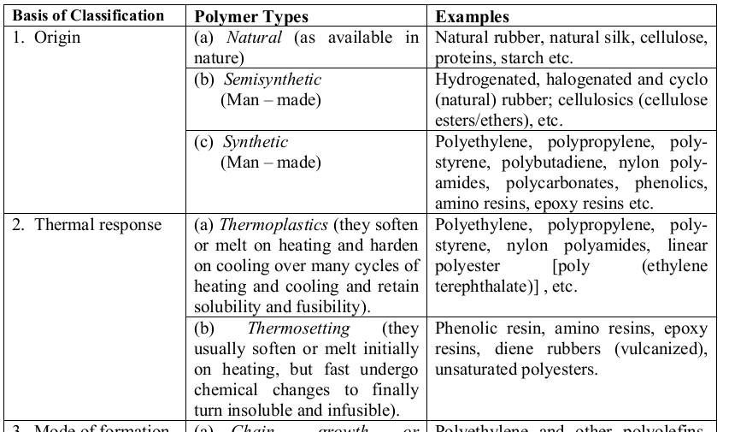
4.1.2. Classification of Polymers

Slide 9
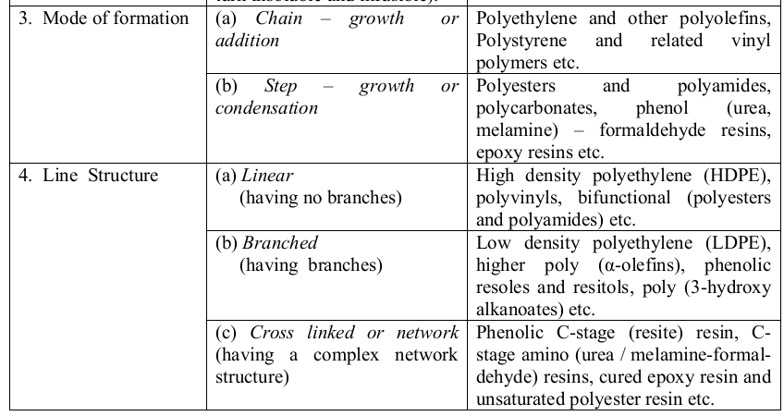
.

Slide 10
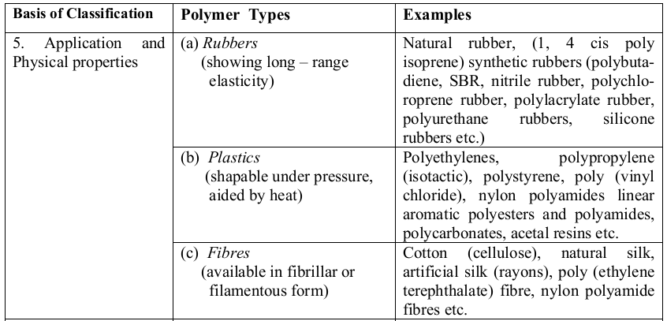
Classification of polymers
.

Slide 11
4.2. Nomenclature of Polymers
One of the classifications of polymers is based on Polymer Structure. e.g. Homochain or Hetrochain polymers.
1) Homochain Polymers
Polymers having all carbon atoms along their backbone are important examples of homochain polymers.
They may be classified depending upon whether there are single, double, or triple bonds along their backbone.
Carbon-chain polymers with only single bonds along the backbone -[C-C-C]- are known as polyalkylenes. e.g. polystyrene, the polyolefins.
e.g., polyethylene ,polypropylene, and polyvinyl chloride.

Slide 12
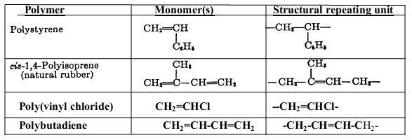
Carbon-chain polymers with double bonds along the chain-[C=C]- such as the diene elastomers-polyisoprene & polybutadiene are called polyalkenylenes.

Slide 13

cont^{d}
(2) Heterochain polymers
They contain more than one atom type in their backbone are grouped according to the types of atoms and chemical groups (e.g., carbonyl, amide, or ester) located along the backbone includes polysiloxanes.
These have a -Si-O- backbone with methyl or other substituent groups attached to silicon.

Slide 14
cont^{d}
A very large number of different polymer structures are possible.
In order to identify these as clearly as possible, it is important to establish a nomenclature system.
Simple vinyl polymers are designated by attaching the prefix poly to the monomer name.
e.g., polystyrene, polyethylene, and polypropylene.

Slide 15
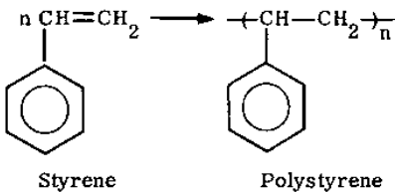
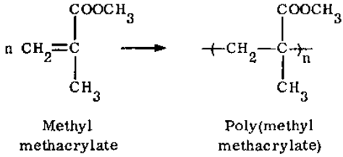
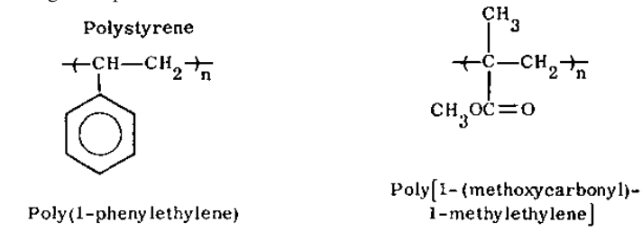
Structure-based Names
Source-based Names
they are based on the common name of the reactant monomer, preceded by the prefix “poly.”
e.g. polystyrene is the most frequently used name for the polymer derived from the monomer 1-phenylethene, which has the common name styrene.

Slide 16
4.3. Methods of Polymerization
4.3.1 Addition and condensation polymerization
Polymerization reaction is a type of reaction that produces polymers from monomers.
Polymerization reaction can be undergoing by various methods.
Such as addition and condensation polymerization.
In addition to classifying polymers on the basis of their processing characteristics, polymers may also be classified according to the mechanism of polymerization.
More specific classification can be made on the basis of polymer structure.

Slide 17
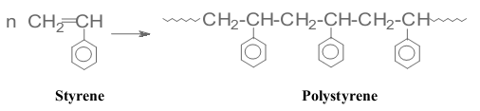
Addition & Condensation Polymerization
4.3. 1 Addition Polymerization
It is a polymerization process that is produced by successive addition reactions.
A carbon-carbon double bond is needed in the monomer.
Most important addition polymers are polymerized from ethylene-based monomers.
Polyethylene which is polymerized by a sequential addition of ethylene monomers.

Slide 18
4.3.2 Condensation Polymerizations
It occurs between monomer or higher high molecular weight intermediate (oligomers) each having complementary functional end units, such as carboxylic acid or hydroxyl groups.
Typically, it occurs by the liberation of a small molecule in the form of a gas, water, or salt.
Common condensation polymers include polyesters (possess ester linkage) & polyamides (possess amide linkage).
e.g. Synthesis of nylon-6,6 by condensation of adipic acid and hexamethylene diamine.

Slide 19
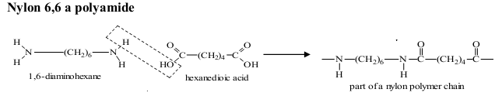

condensation polymerization
.
Another important example of a polycondensation is the preparation of polycarbonate from bisphenol-A & phosgene.
Here, two molecules of HCl are formed for each repeating unit.

Slide 20
4.5 Effect of Polymer Structure on Properties
4.5.1 Properties of Polymers
Molecular weight:
molecular weight of polymers is not fixed because of varying chain length.
ii) Crystallinity
Because of high molecular weight & varying chain length, most polymers are amorphous & only semi-crystalline.
Those with high crystallinity are tougher, more opaque, & more resistant to solvents, higher density & sharply defined melting point.

Slide 21
Properties of polymers
In addition, polymers have the following typical properties:
Good chemical resistant at room temperature
Low density, brittleness at low temperature
Low strength & chemical resistance at high temp.
Processibility at relatively low temperature
Generally good insulators( except conductive polymers)
Often transparent and good optical properties
Gas permeability
Recycling

Slide 22
4.6 Plastics-properties and classification
Focuses of this lesson will be:
i) What are plastics?
ii) List the major properties of plastics
iii) Explain the basic classification of plastics
iv) Compare and contrast thermoplastics and thermosetting
v) List some of the major uses of plastics

Slide 23
4.6.1 Plastics
A plastic is a material that contains an essential ingredient, an organic substance of a large molecular weight, is solid in its finished state, & at some stage in its manufacture or in its processing into finished articles, can be shaped by flow.
The word plastic is derived from the Greek plastikos meaning capable of being shaped.
It refers to their malleability, or plasticity during manufacture, that allows them to be cast, pressed, or extruded into a variety of shapes-such as films, fibers, plates, tubes, bottles, boxes, and much more.

Slide 24
The vast majority of plastics are composed of polymers of C & H alone or with O, N, Cl or S in the backbone.
4.6.2 Thermoplastics (thermo softening plastics)
They are high molecular weight polymers whose chains associate through weak Van der Waals forces, stronger dipole-dipole interactions & H-bonding of aromatic rings.
They can be softened & molded on heating.
They are elastic & flexible above certain glass transition temp.

Slide 25
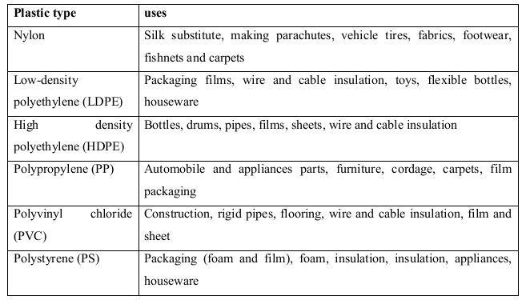
Plastics
Table 4.6.2. Example of thermoplastic and their uses

Slide 26
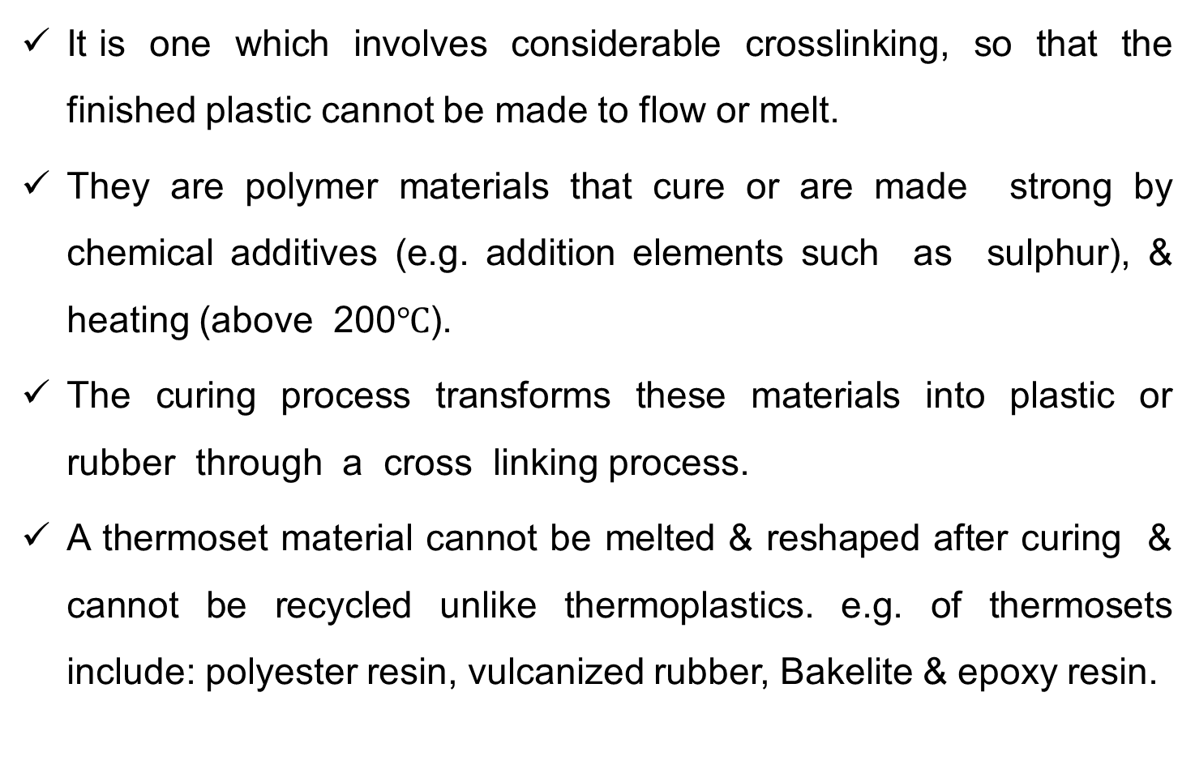
4.6.3 Thermosetting plastics (thermosets)

Slide 27
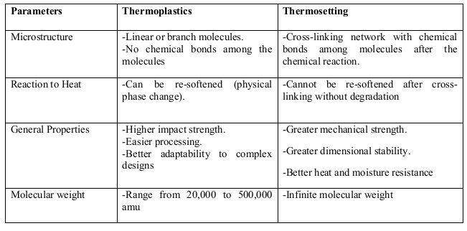
thermosetting plastics
Table. Structures & properties of thermoplastics & thermosets

Slide 28
4.7 Molding constituents of plastics in to articles
Molding of a plastic is a process of making a hollow form or matrix into which a plastic material is placed & which imparts to the material its final shape as a finished article.
The common molding of plastics into articles is blow molding.
Blow molding (blow forming) is a manufacturing process by which hollow plastic parts are formed.
there are 3 main types of blow molding:
1) Extrusion blow molding,
2) Injection blow molding, and
3) stretch blow molding.

Slide 29
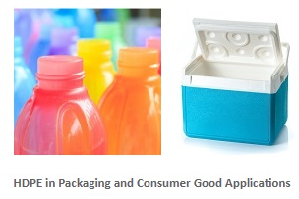
4.8 Preparation, properties & uses of PE, PVC and Bakelite
Common synthetic organic polymers are polyethylene (polyethene), polypropylene, nylon, teflon (PTFE), polystyrene, polyesters, polymethylmethacrylate (perspex), & PVC.
Preparation, properties & uses of Polyethylene (PE)
Three major classes of polyethylene. These are:
low density polyethylene (LDPE),
high density polyethylene (HDPE) and
linear low density polyethylene (LLDPE).
Pellets of these plastics are extruded & blown to produce film. This film is used for packaging and making plastic bags.

Slide 30
2) The Polyethylene Manufacturing Process
Today, PE manufacturing processes are usually categorized into high pressure & low pressure operations.
The former is recognized as producing conventional LDPE while the latter makes HDPE & LLDPE polyethylenes.
The most common method used in industry is to polymerize ethylene by means of a fluidized reactor bed.
A fluidized reactor bed consists of metallic catalyst particles that are fluidized by the flow of ethylene gas.
Implies catalyst particles are suspended in the ethylene fluid as ethylene gas is pumped from the bottom of the reactor bed to the top.

Slide 31
4.8.2 Preparation, properties & uses of Polystyrene (PS)
PS is a rigid, brittle, inexpensive plastic that has been used to make plastic model kits & similar knick-knacks.
It would also be the basis for one of the most popular "foamed“ plastics, under the name styrene foam.
Foam plastics can be synthesized in an "open cell" form, in which the foam bubbles are interconnected, as in an absorbent sponge, & "closed cell", in which all the bubbles are distinct, like tiny balloons, as in gas-filled foam insulation and flotation devices.
It finds much current use as the substance of toy figurines & novelties.

Slide 32

Preparation, properties & uses Polyvinylchloride (PVC)
PVC has side chains incorporating chlorine atoms, which form strong bonds.
PVC in its normal form is stiff, strong, heat & weather resistant, & is now used for making plumbing, gutters, house siding, enclosures for computers & other electronics gear.
It can also be softened with chemical processing, and in this form it is now used for food packaging, and rain gear.

Slide 33
Preparation, properties & uses PVC
All PVC polymers are degraded by heat and light.
When this happens, HCl is released into the atmosphere & oxidation of the compound occurs.
Because HCl readily combines with water vapor in the air to form hydrochloric acid, polyvinyl chloride is not recommended for long-term archival storage of silver, photographic film or paper.

Slide 34
Preparation, properties & uses Bakelite
Bakelite is a thermosetting phenol formaldehyde resin, formed from an elimination reaction of phenol with formaldehyde, usually with wood flour filler.
It was used for its electrically nonconductive and heat resistant insulators, & also in such products as kitchen ware, jewellery, children‘s toys & etc.
Baekeland was looking for an insulating shellac to coat wires in electric motors & generators.

Slide 35
Preparation, properties & uses Bakelite
Baekeland found that mixtures of phenol (C₆H₅OH) & formaldehyde (HCOH) formed a sticky mass when mixed together & heated, and the mass became extremely hard if allowed to cool.
He continued his investigations & found that the material could be mixed with wood flour, asbestos, or slate dust to create "composite" materials with d/t properties.
Most of these compositions were strong & fire resistant.
Baekeland built pressure vessels to force out the bubbles and provide a smooth, uniform product.

Slide 36
Preparation, properties & uses Bakelite
Bakelite was the first true plastic.
It was a purely synthetic material, not based on any material or even molecule found in nature.
It was also the first thermosetting plastic.
Thermoset plastics are tough and temperature resistant.
Bakelite was cheap, strong, and durable.
It was molded into thousands of forms, such as cases for radios, telephones and clocks, and balls.

Slide 37
4.9 Rubber and its properties
4.9.1 Chemistry and Properties of rubber
All rubberlike materials are polymers, which are high molecular weight compounds consisting of long chains of one or more types of molecules, such as monomers.
Vulcanization (or curing) produces chemical links between the loosely coiled polymeric chains; elasticity occurs b/c the chains can be stretched & the crosslinks cause them to spring back when the stress is released.
Natural rubber is a polyterpene, i.e., it consists of isoprene molecules linked into loosely twisted chains.

Slide 38
4.9 Rubber and its properties
4.9.1 Chemistry and Properties of rubber
The monomer units along the backbone of the carbon chains are in a cis arrangement and it is this spatial configuration that gives rubber its highly elastic character.
Unvulcanized rubber is soluble in a number of hydrocarbons, including benzene, toluene, gasoline, and lubricating oils.
Rubber is water repellent and resistant to alkalies & weak acids.
Rubber's elasticity, toughness, impermeability, adhesiveness, and electrical resistance make it useful as an adhesive, a coating
composition, a fiber, a molding compound, and an electrical insulator

Slide 39
4.10 Natural and synthetic rubber
Natural rubber is an elastomer (an elastic HC polymer) that was originally derived from latex, a milky colloidal suspension found in the sap of some plants.
Vulcanized rubber; this is a form of natural rubber heated with, mostly, sulfur forming cross-links between polymer chains (vulcanization), improving elasticity & durability.
The advantages of natural rubber are less buildup of heat from flexing & greater resistance to tearing when hot.

Slide 40
Natural and synthetic rubber
Synthetic rubber is any type of artificially made polymer material, which acts as an elastomer.
An elastomer is a material with the mechanical (or material) property that it can undergo much more elastic deformation under stress, than most materials and still return to its previous size without permanent deformation.
Example: Bromo Isobutylene Isoprene, Polybutadiene.
synthetic rubber has the following advantages over natural rubber:
better aging & weathering, more resistance to oil, solvents, oxygen, ozone, & certain chemicals, & resilience over a wider temp. range.

Slide 41
Natural and synthetic rubber
Styrene Butadiene Rubber (SBR): Manufacturing Process
SBR is produced by the copolymerization of butadiene with styrene in the approximate proportion of 3:1 by weight.
In the emulsion process, which produces general purpose grades, the feedstocks are suspended in a large proportion of water in the presence of an initiator or a catalyst and a stabiliser.
In the solution process, the copolymerisation proceeds in HC solution in the presence of an organometallic complex. This can be either a continuous or batch process.

Slide 42
4.11 Natural and synthetic fibers
Fiber is a class of materials that are continuous filaments or are in discrete elongated pieces, similar to lengths of thread.
They are very important in the biology of both plants & animals, for holding tissues together.
Natural fibers include those produced by plants, animals, & geological processes.
They are biodegradable over time.

Slide 43
4.11 Natural and synthetic fibers
Fibers can be classified according to their origin; as fiber, Mineral, Animal and Vegetable fibers.
Vegetable fibers are generally based on arrangements of cellulose, with lignin: examples include cotton and sisal. Plant fibers are employed in the manufacture of paper & textile (cloth).
Wood fiber is from tree sources. Forms include ground wood, thermo mechanical pulp (TMP) & bleached or unbleached sulfite pulps, refer to the type of pulping process used to remove the lignin bonding.

Slide 44
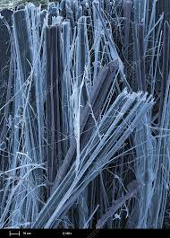
Natural and synthetic fibers
Animal fibers consist largely of particular proteins. Examples are spider silk, sinew, catgut, wool and hair such as cashmere, mohair and angora, etc.
Mineral fibers comprise asbestos.
Asbestos is the only naturally occurring
long mineral fiber.
Synthetic or man-made fibers
Sources from synthetic materials such as petrochemicals.
But some types of synthetic fibers are manufactured from natural cellulose, including rayon.
Asbestos

